Slide 1
FAKE NEWS DETECTION
By Disha Panchal

Slide 2
Introduction:
This project is a Fake News Detection App built using Python and Tkinter.
It allows users to input a news headline and predicts whether it is real or fake using a pre-trained machine learning model.
The app features a simple and interactive graphical user interface, making it user-friendly and accessible as a standalone desktop application.
This project demonstrates the integration of machine learning with GUI development and highlights practical applications of text classification in addressing misinformation.

Slide 3
Technologies Used in This Project:
Python
Tkinter
Machine Learning: A pre-trained machine learning model was used for fake news classification. The model was trained using libraries like scikit-learn.
Pickle: Used for saving and loading the vectorizer (vectorizer.pkl) and the ML model (finalized_model.pkl).
Text Vectorization: The text input from users was converted into a numeric format using a TF-IDF Vectorizer to make it suitable for ML predictions.
Jupyter Notebook : Likely used during the development and training phase of the machine learning model for experimentation.

Slide 4
Things I learned from this project
Building GUI Applications:
Machine Learning Integration:
Error Handling in Python:
User-Centric Design:
Learned how to use Tkinter to create a graphical user interface for desktop applications.
Gained hands-on experience in integrating a pre-trained machine learning model into a real-world application.
Implemented error-handling mechanisms to provide feedback for invalid inputs or application errors.
Focused on creating an application that is intuitive and easy for users to operate

Slide 5
Link to Tutorial used
https://youtu.be/z_mNVoBcMjM?si=ApmPHjBIITQgonFB

Slide 6
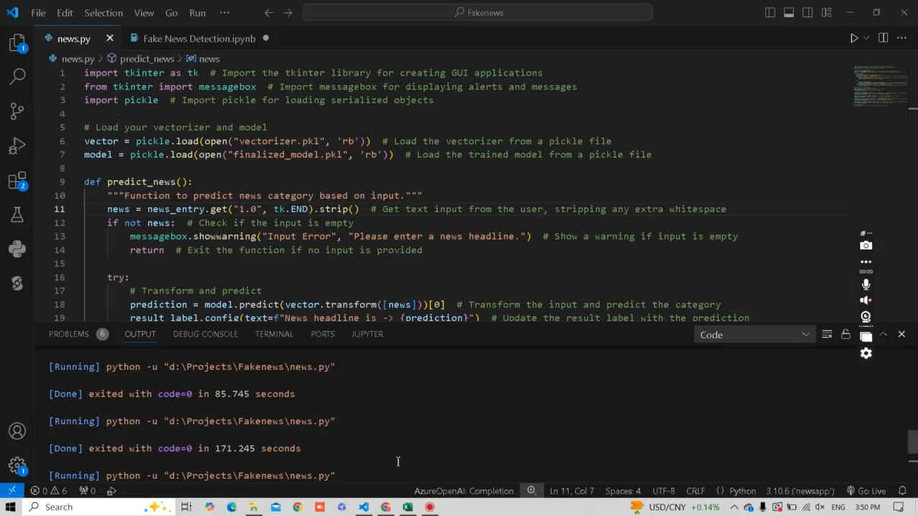
Demo Recording

Slide 7
Thank You

